Slide 1
Data Mining - Welcome
Nga Than, Hunter College, Jan - 27, 2020

Slide 2
The class
ME: Nga Than - PhD Candidate at CUNY - the Graduate Center
YOU?

Slide 3
Introduction
ME: Nga Than - PhD Candidate at CUNY - the Graduate Center
YOU?

Slide 4
Introduction
What is data science? How is it different from sociology and social sciences?
What is data mining?
How does this course work?

Slide 5
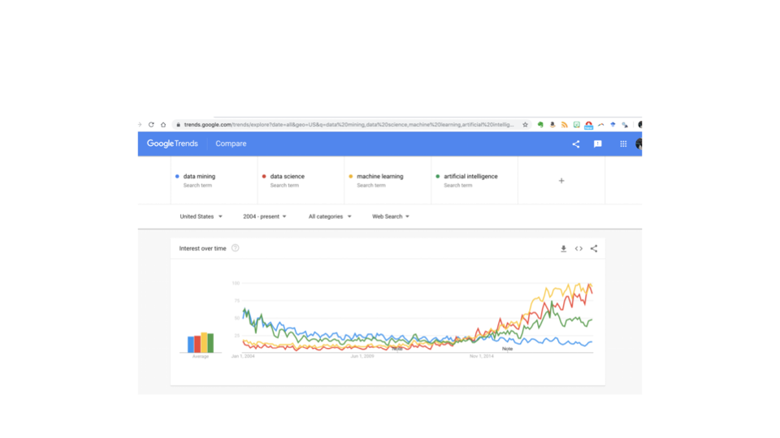

Slide 6
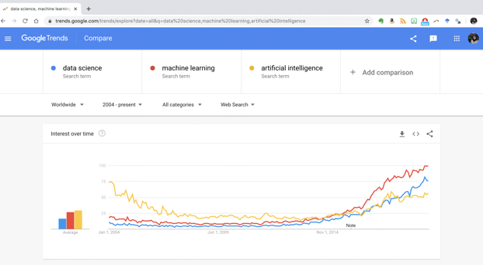

Slide 7
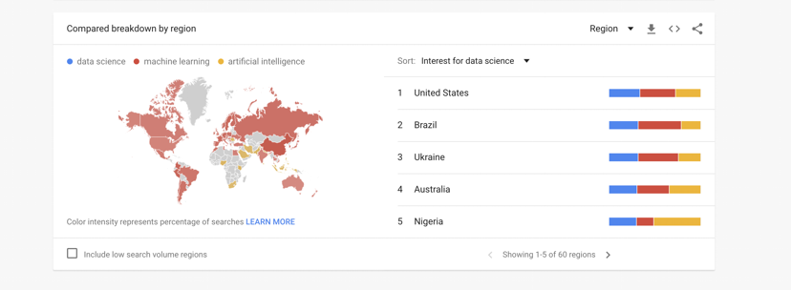

Slide 8
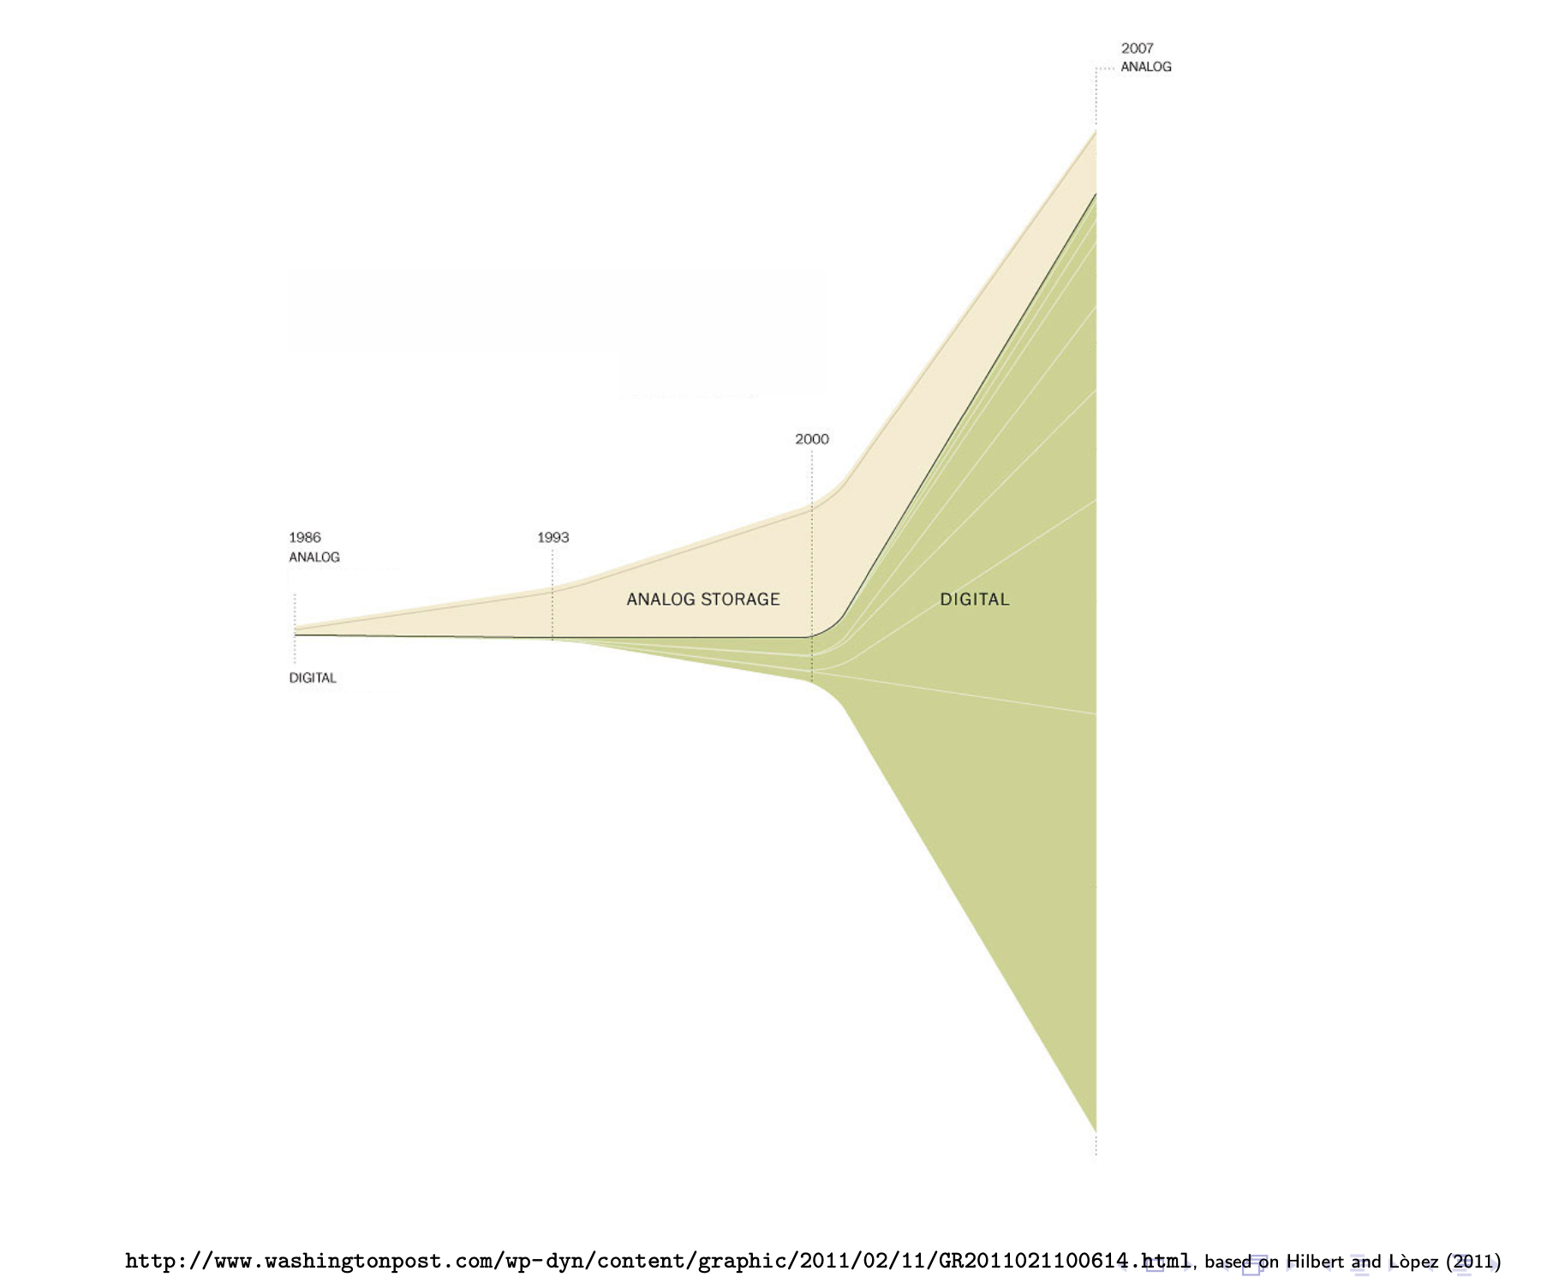

Slide 10
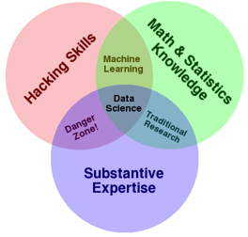
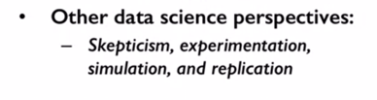
Drew Conway–Data Science

Slide 11
R Programming Language
A free software for statistical computing
Widely used by data scientists for data analysis
You should install:
R: https://www.r-project.org/
RStudio: https://rstudio.com/products/rstudio/download/

Slide 12
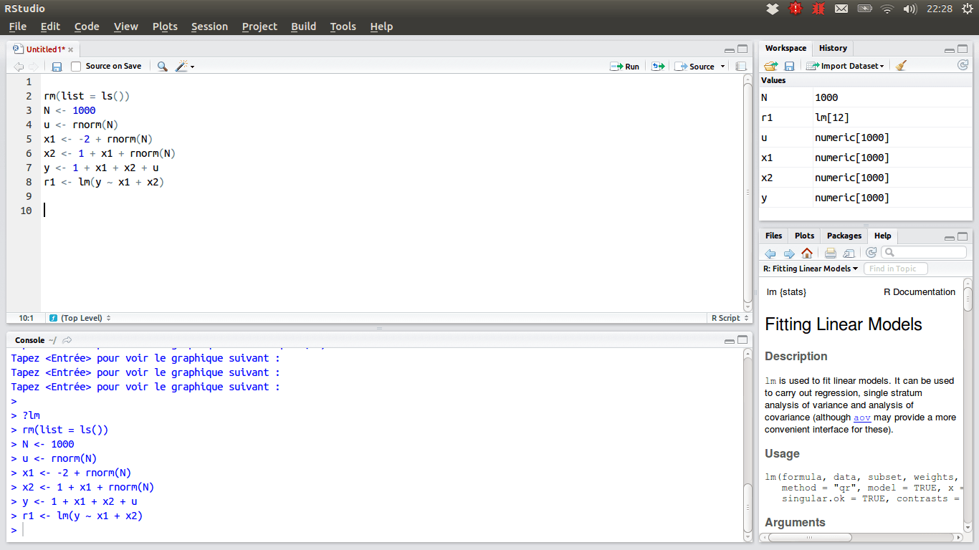

Slide 13
Communications
Emails: nthan@gradcenter.cuny.edu
Slack:
Install:
Desktop: https://slack.com/downloads/windows
Cellphone
a communication platform that facilitates group work
Join: datahunters2020.slack.com
Website: https://ngathan.com/data_mining.html
Github: github.com/ngathan/DataMiningS2020 <- Most of lecture notes, readings and datasets will be here

Slide 14
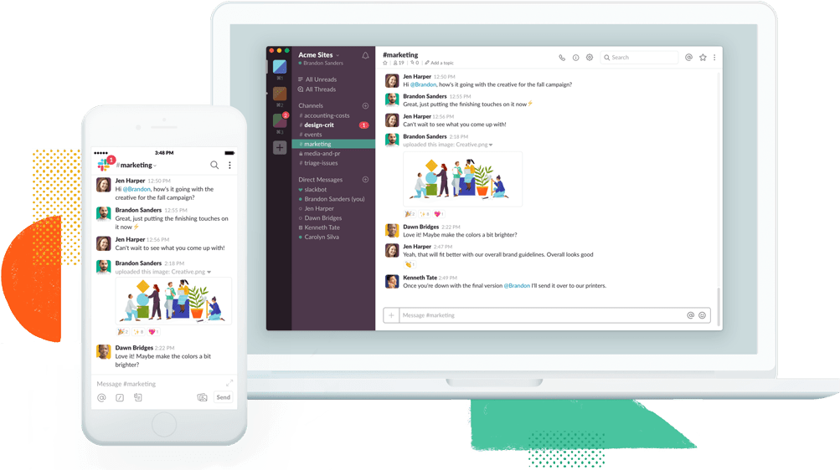

Slide 15
Teaching Philosophy
Use as much as possible free, and open-source software and textbooks
Stay away from Blackboard
Syllabus Explanation

Slide 16
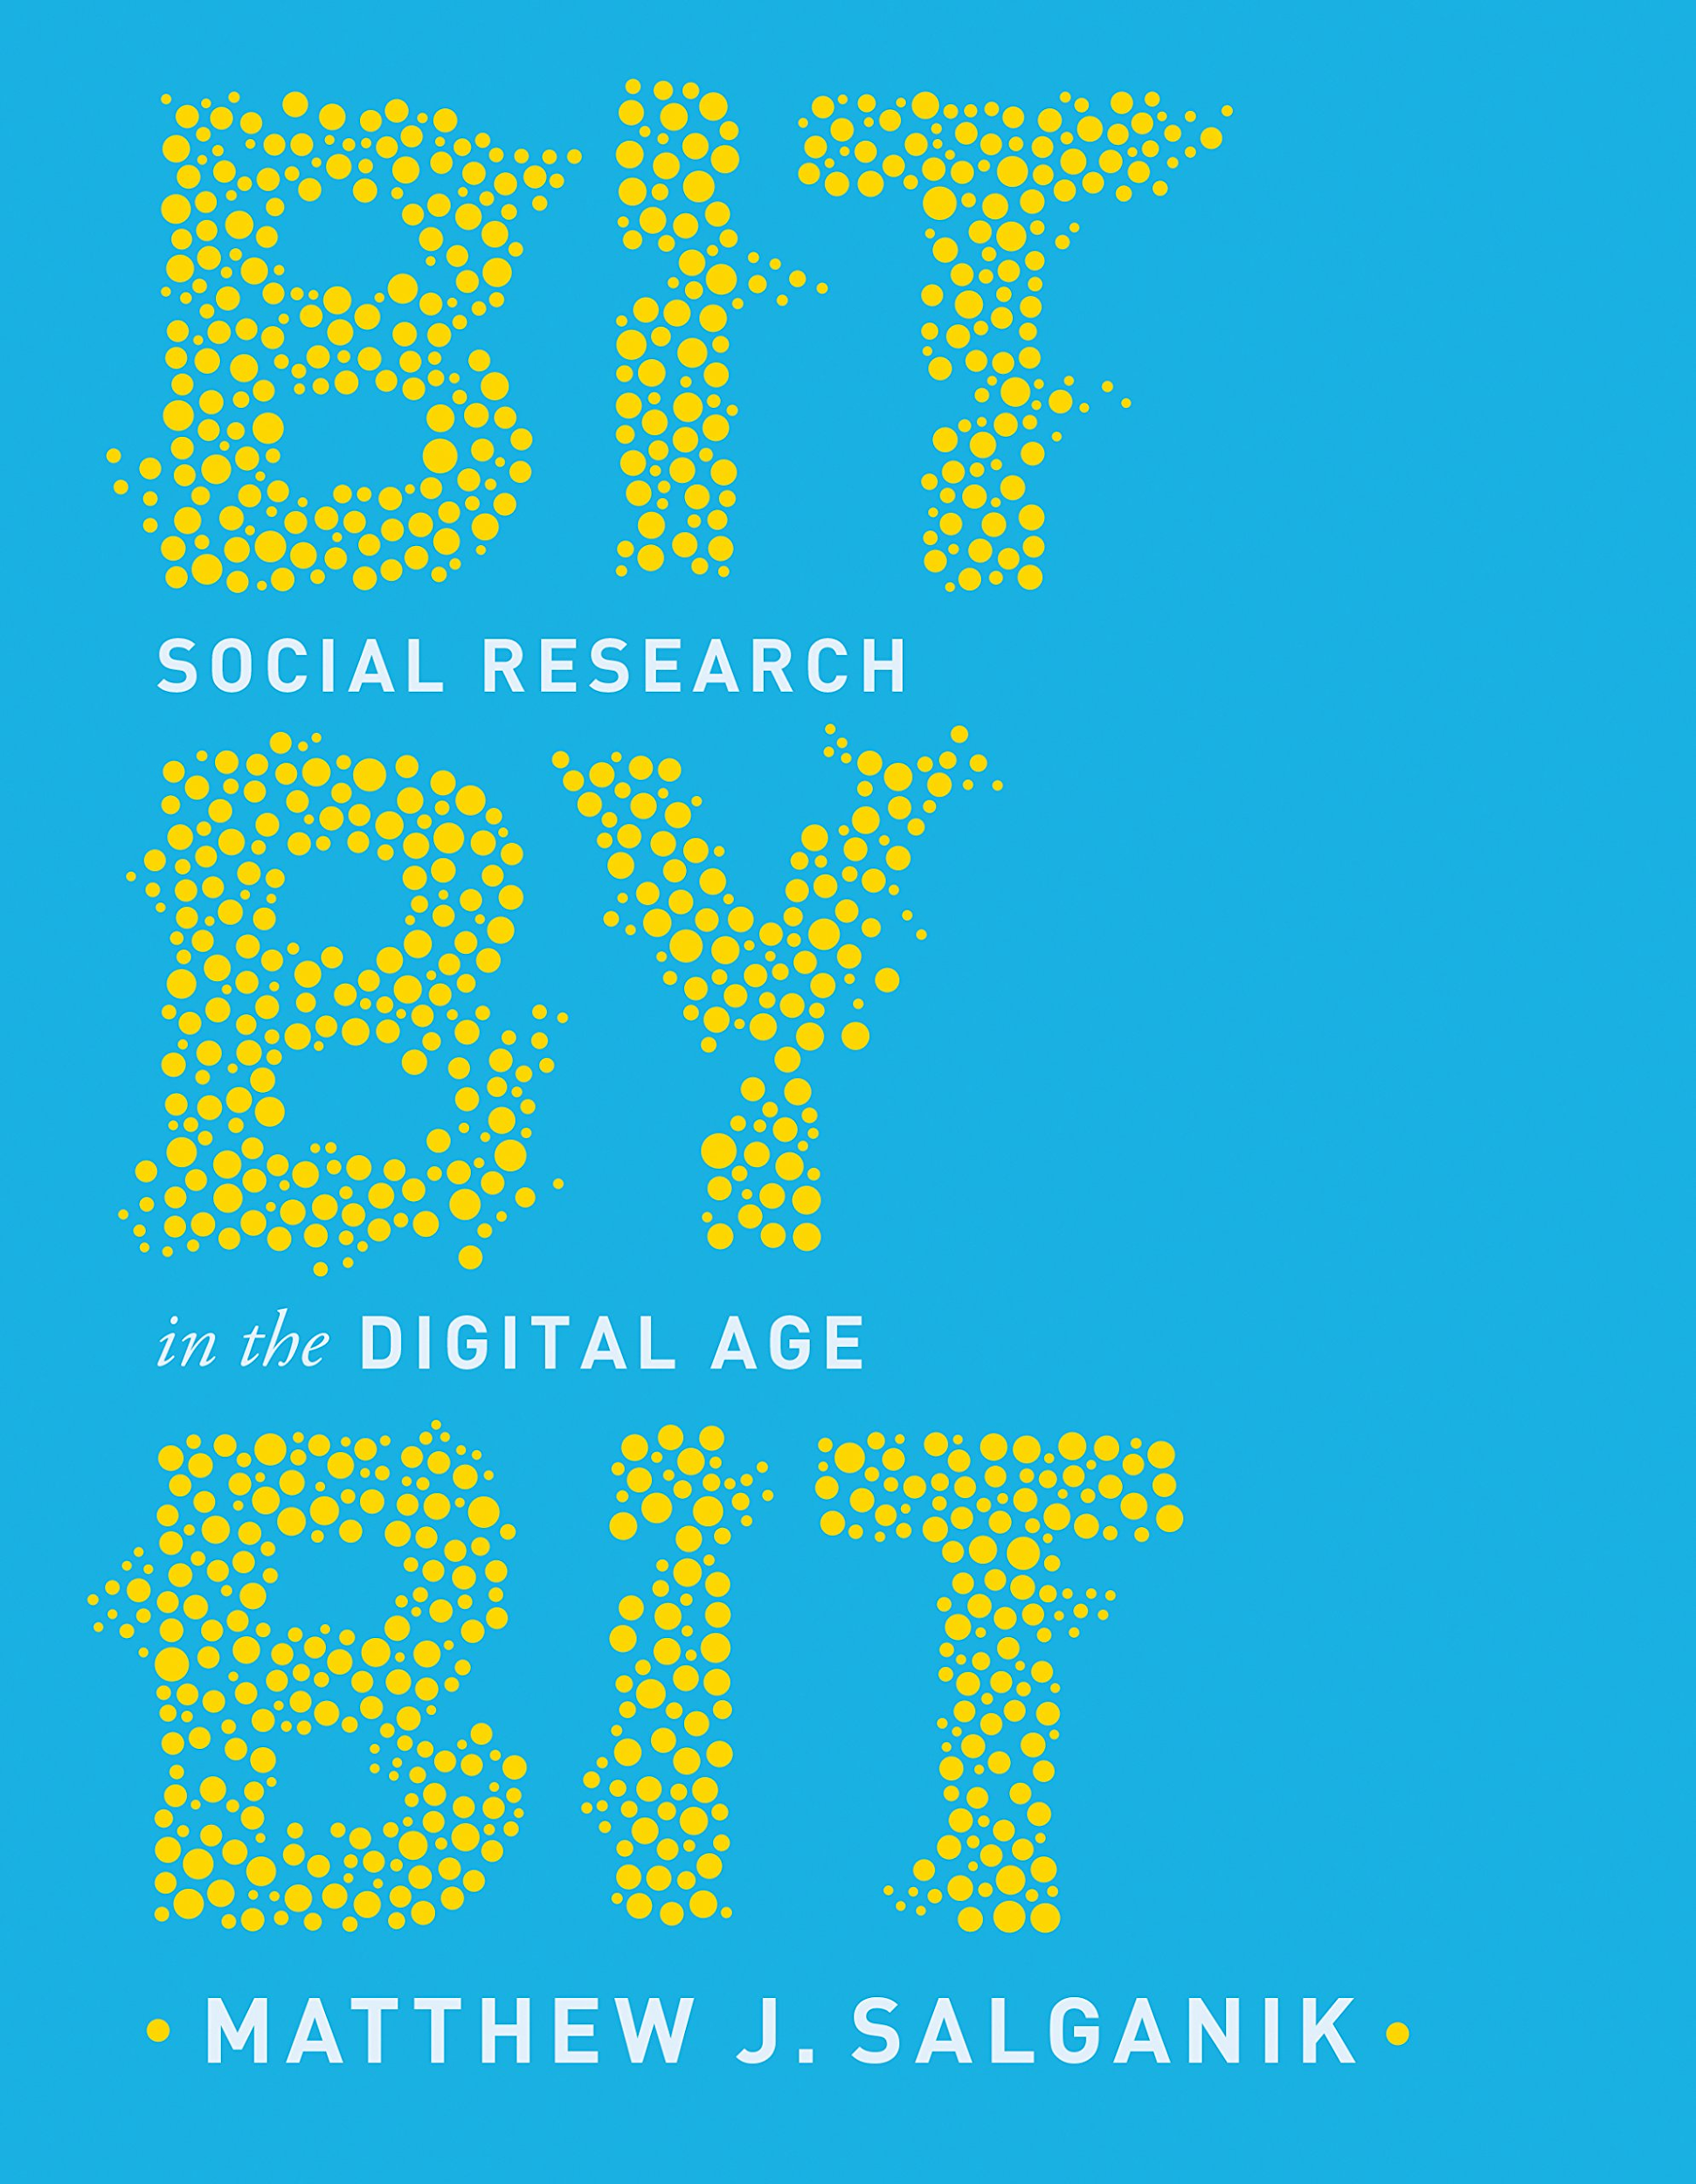
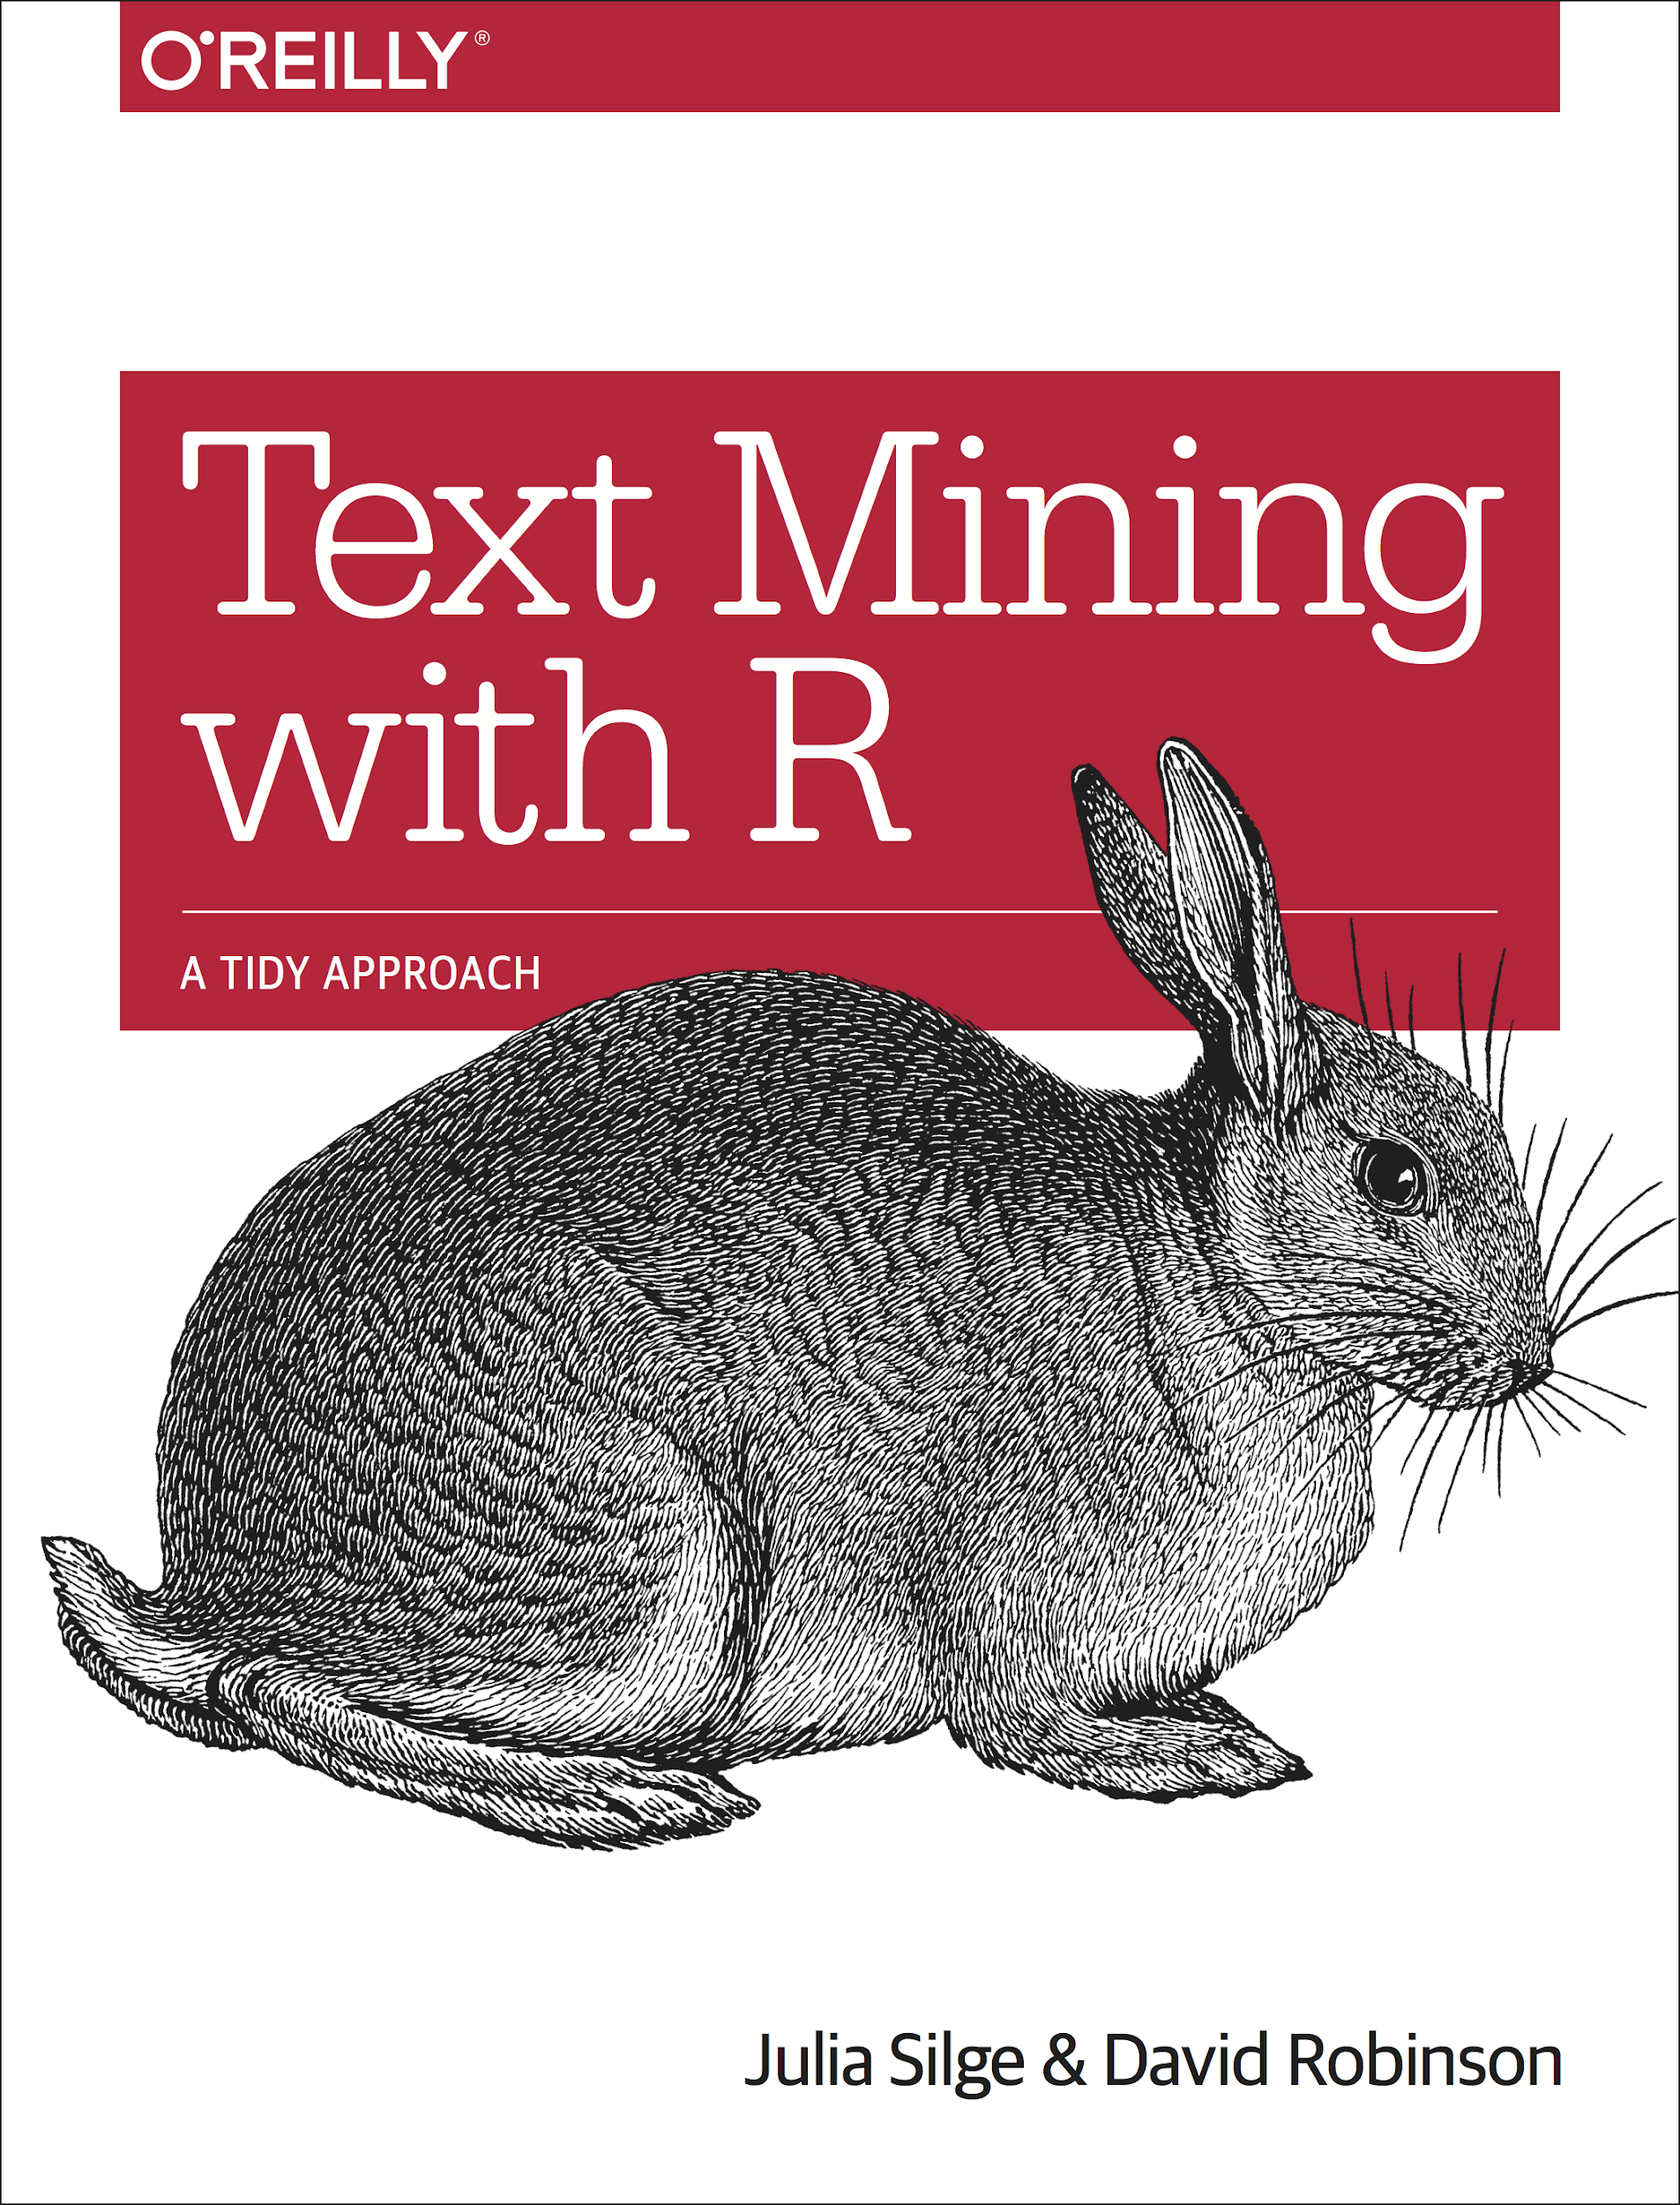

Textbooks

Slide 17
What is your learning philosophy?

Slide 18
Install Required Software
R & RStudio
Slack

Slide 19
Week 1 - Evaluation
https://tinyurl.com/DM2020-W1

Slide 20
